Slide 1
625th Strategic Operations Squadron Commander’s Call (June 2018)
Lt Col Hayley S. James
Commander

Slide 2
Overview
Decoration Presentation
Awards & Passes
Fitness Program
Safety
Announcements
Flight Updates
History Brief
DO’s Comments
Commander’s Comments

Slide 3
Decoration

Slide 4
Awards and Passes

Slide 5
Passes
Birthdays
Lt Col Hlivko – 7 July
Capt Yarrinton – 9 July
Capt Bouvier – 11 July
Capt Flaherty – 13 July
Capt Hickman – 17 July
Capt Cline – 22 July
Capt Rego – 31 July
Anniversaries
Capt Wenta & Courtney – 9 July
Capt Wright & Andrew – 16 July
Capt Plath & Andrea – 21 July
Commission & EAD
Capt Johnson – 15 May

Slide 6
Fitness Program

Slide 7
Squadron PFA Stats

Slide 8
Reminders
PT Policies
No Uniform
Sq T-shirt encouraged
Participation Expected
Passes awarded by Lt Col James
99+ = 3 day
95+ = 2 day
90+ = 1 day
+5 pts = 1 day
PFA Expectations
Test in 1st half of the month (2 wks before due date)
Notify UFPM of test date
FSQ (copy) / Scoresheet
Practice test at least 1 week before test
For those <90

Slide 9
PT Excellence
91.3 Capt Friend
99.3 Capt Wolfe
94.8 TSgt Clark

Slide 10
STEP – STRIPES FOR EXCEPTIONAL PERFORMERS
Limited number of exceptional enlisted directly promoted to SSgt and TSgt
MAJCOM CC selects from the quota
AFGSC 16 stripes
All nomination packages are boarded Group to Wing to NAF to MAJCOM
Senior Rater nomination, 1206 w/ 5 bullets and last 3 EPRs
Eligible SrA and SSgt must meet TIS and TIG requirements
SrA 3 years TIS and at least 6 months TIG
SSgt 5 years TIS and at least 12 months TIG
ALS still required for SrA to promote to SSgt
If not completed a waiver is required but member is still eligible
Selection notification date becomes the effective date and the date of rank no earlier than 1 Sep 2018

Slide 11
Safety

Slide 12
Safety
100 Days of summer – Sun Safety
Don’t Feel the Burn
Drink Up
Hydrate
Electrolytes
Wear sunscreen
Take breaks from the sun often
Hats, sunglasses
Feeling Hot?
Heat Exaustion
Weakness, dizziness, nausea
Move to cool place, sip water, loosen clothes, wet towel
Heat Stroke
Elevated body temp, rapid pulse
Move to cool place, wet towel, DO NOT DRINK
Heat Cramp
Muscle pain, heavy sweating
Move to cool place, drink water, cool down

Slide 13


Operational Safety Review
STOS Flight Safety
Foreign Object Debris (FOD check)
Hearing protection
Tripping Hazards
Heat awareness and preparation
Hydration
Sunscreen
Body Temperature

Slide 14
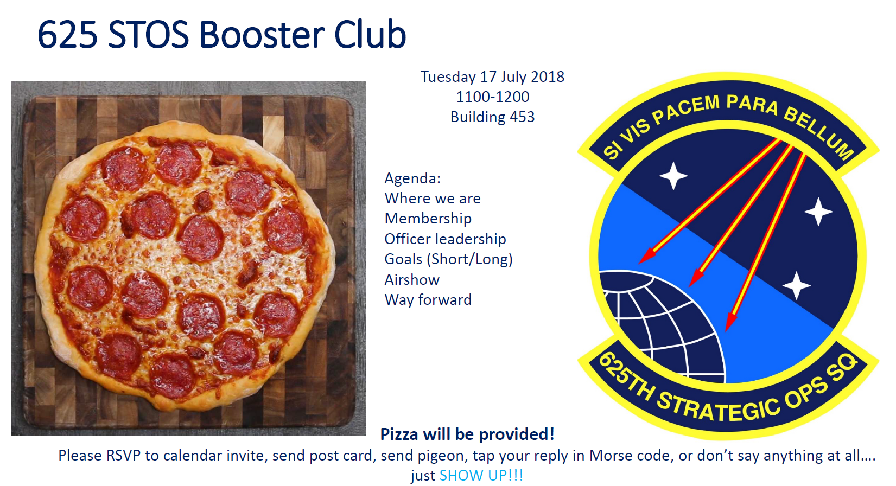
Announcements

Slide 15
SAPR – 2d Quarter
Unrestricted: investigated & command auth’s aware
Restricted: confidential, not investigated, reported to SARC, SAPR VA, health care
Exceptions:
Victim provides written authorization
To prevent/lessen serious threat to anyone’s health/safety
Disability Eval Board & Med Eval Board
When required by Law
Notes:
Here’s our overview. We’re going to talk about who we are, why we’re here, and what we do.

Slide 16
SAPR – 2d Quarter
Reporting out the Chain of Command
When alleged subject is CC or in CoC, options are:
Next Sr CO
CC outside CoC
OSI
IG
SVC
DoD Safe Helpline
Notes:
Here’s our overview. We’re going to talk about who we are, why we’re here, and what we do.

Slide 17
SAPR – 2d Quarter
Independent Investigation
When info regarding sexual assault is provided to LE by someone other than the victim (Victim can elect not to participate)
Mandatory reporters: CCs, 1st Sgts, CoC, LE
Independent investigation is opened BEFORE victim files report with SAPR office: only unrestricted reported option available
Notes:
Here’s our overview. We’re going to talk about who we are, why we’re here, and what we do.

Slide 18
Parental Leave
3 forms of non-chargeable leave
Convalescent leave (every birth mother, 42 days)
Primary caregiver leave (42 days)
Reduced 1 day for each add’l convalescent day
Secondary caregiver leave (21 days)
Designate primary & secondary caregiver
Taken anytime within first year
Retroactive: 23 Dec 16 – 22 Mar 18 (18 months)
23 Mar 18 & on: 1 year
Notes:
Here’s our overview. We’re going to talk about who we are, why we’re here, and what we do.

Slide 19
595 C2G CoC
CoC & CC: Mandatory unless approved by me, incl C2
Col Baldwin
Different from Col Billings
Suspense’s
Human capital
Deserves our support
First focus area
Notes:
We envision ourselves as nuclear professionals that deliver unique combat capabilities. Our mission is to execute and support global strike.

Slide 20
Stripes for Exceptional Performers
What is it?
Notes:
We envision ourselves as nuclear professionals that deliver unique combat capabilities. Our mission is to execute and support global strike.

Slide 21
Stripes for Exceptional Performers
What is it?
Prgm to promote exceptional enlisted Amn early
…to grades of SSgt (6 mos TIG) & TSgt (1 yr TIG)
Based on recommendations from CC’s with personal knowledge of Amn
Requires 1206
FY 18 – 96 → 180
Notes:
We envision ourselves as nuclear professionals that deliver unique combat capabilities. Our mission is to execute and support global strike.

Slide 22
AF Handbook
How to address SMSgt?
MSgt CCAF
Different from Col Billings
Suspense’s
Human capital
Deserves our support
First focus area
Notes:
We envision ourselves as nuclear professionals that deliver unique combat capabilities. Our mission is to execute and support global strike.

Slide 23
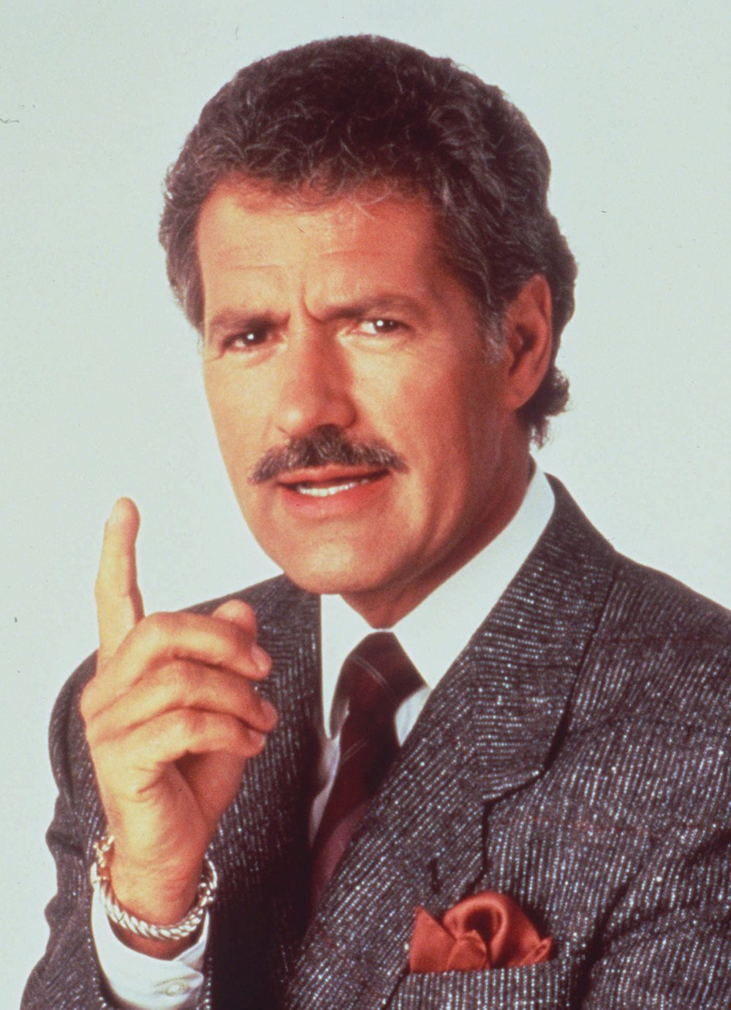

Slide 24

Series of questions in 2 categories
Contestants will choose dollar amounts within the categories (example: “We’ll take SAPR Reporting Options for $300”)
Important, contestants must wait for me to finish reading the question before buzzing in

Slide 25
Must provide answer in the form of a question (example - “What is a restricted report”)
Correct answer--dollar amount will be added to score
Wrong answer--dollar amount will be deducted from score
Wrong answer--other teams can buzz in after I read the question again

Slide 26

HERE ARE TODAY’S CATEGORIES
Theme
Timer
Lose
Cheer
Boo
Silence
Notes:
Family Feud Template
Introduction Slide – Family Feud!

Slide 27
Reporting Options
Ooooh…

Slide 28
Random SAPR Knowledge
Aaaah…

Slide 29
Reporting Options
Ooooh…
Random SAPR Knowledge
Aaaah…
$100
$100
$200
$200
$300
$300
$400
$400
$500
$500
H

Slide 30
This reporting option is investigated and command authorities are made aware
H

Slide 31
What is Unrestricted Reporting?
H

Slide 32
You may report to these people and maintain a restricted report.

Slide 33
Who are the SARC, SAPR VA, or healthcare personnel?
H

Slide 34
This reporting option is not investigated and the information is kept confidential
H

Slide 35
What are restricted reports?
H

Slide 36
When information regarding a sexual assault is provided to law enforcement by someone other than the victim.
H

Slide 37
What is an independent investigation?
H

Slide 38


Slide 39
Commanders, First Sergeants, chain of command (including supervisors, supervisory chain, AF instructors) who have knowledge of a sexual assault.
H

Slide 40
Who are mandatory reporters?
H

Slide 41
A freely given agreement to the conduct at issue by a competent person
H

Slide 42
What is consent?
H

Slide 43
This resource is a hotline and an app that provides on-line, phone, and text support.
H

Slide 44
What is the DoD Safe Helpline?
H

Slide 45
This agency handles Sexual Assault Investigations.
H

Slide 46
Who is OSI?
H

Slide 47
SARC, SAPR VA, medical, SVC, and chaplain.
H

Slide 48
Who can maintain confidentiality ?
H

Slide 49
A sleeping, unconscious, or incompetent person cannot provide this

Slide 50
What is consent?

Slide 51

H

Slide 52
In what situation can the victim report to the following:
Next senior commanding officer
Commanders outside the chain of command
OSI
IG
Talk to SVC
Talk to SARC/SAPR Office
Calling DOD Safe Helpline
H

Slide 53
When the subject of the sexual assault is the commander or in the victim’s chain of command?
H

Slide 54
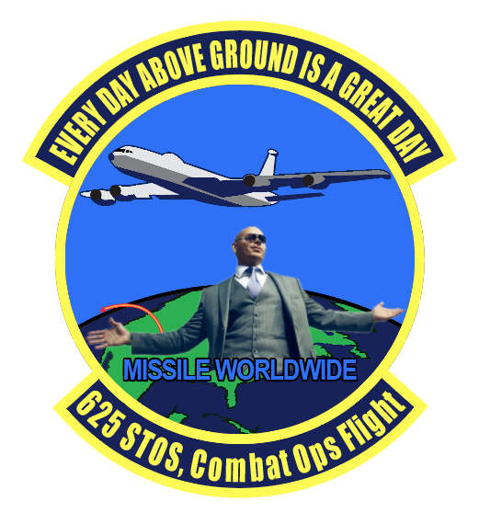
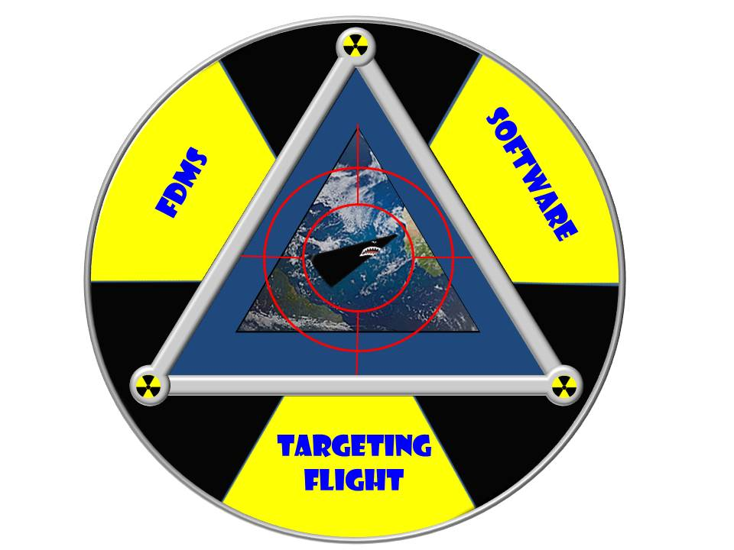



Flight Updates
DOW

Slide 55
The sound of nuclear detection

Slide 56
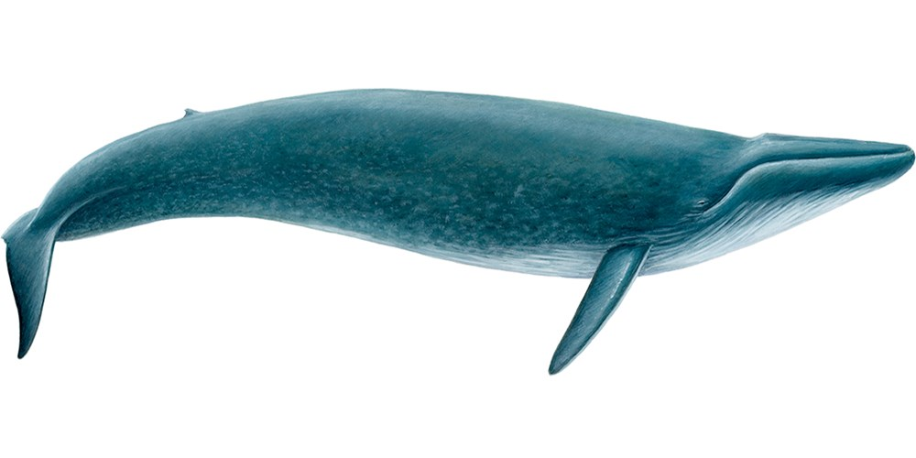
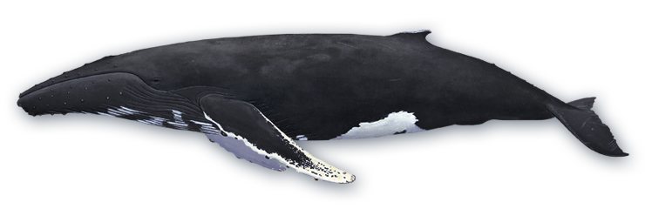
Overview
What?
Who?
World War II
War Ends
Project Mogul
Why?
New Mexico
Weather Balloon

Slide 57
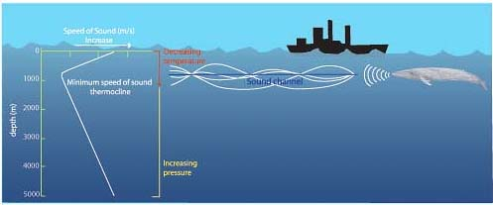
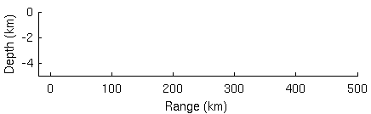
What?
SOFAR Channel
Sound Fixing And Ranging Channel
Refraction
Depth
1000 ft, 750 ft-1250 ft
Temperature, salinity, pressure
Sound caught in channel transfers farther, up to 1000’s of miles horizontally
Whales, submarines

Slide 58
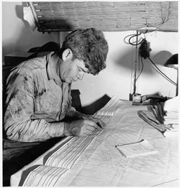
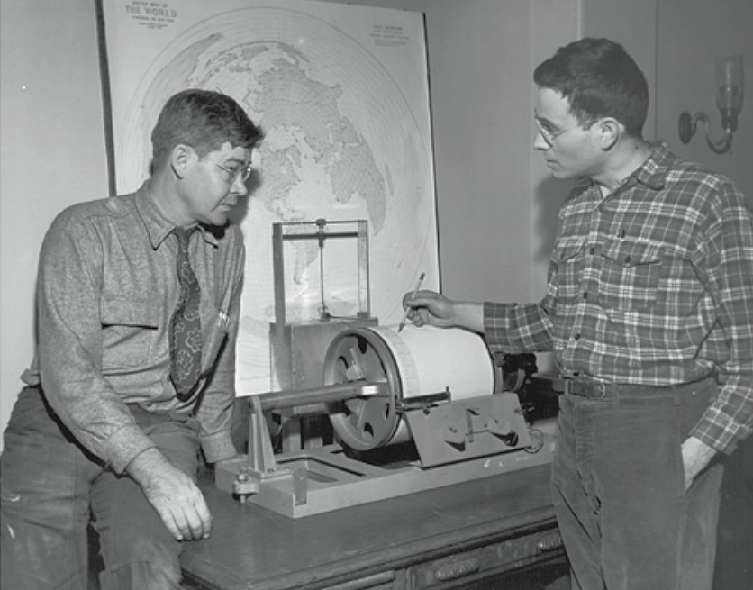
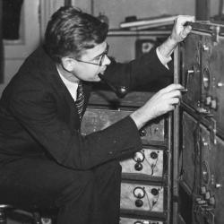
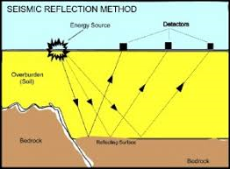
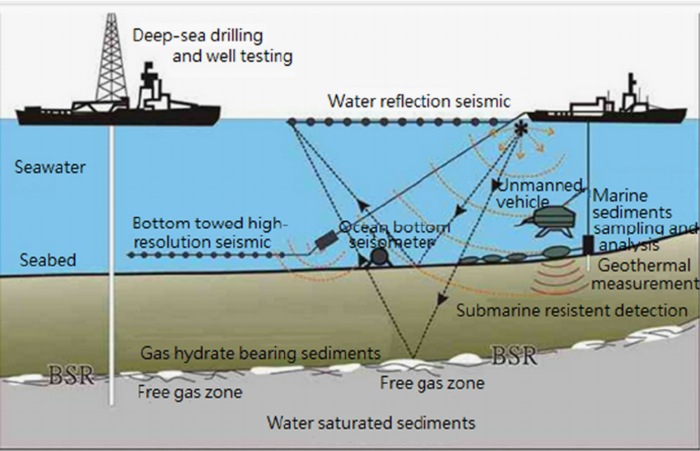
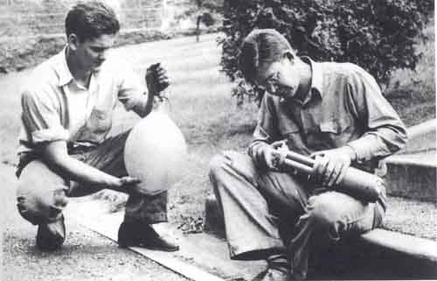
Who?
Maurice Ewing, Physicist
Geologist, Oceanographer
Shell Oil Company
Explosives
Seismic detection
Identified sound channel during 1930s

Slide 59
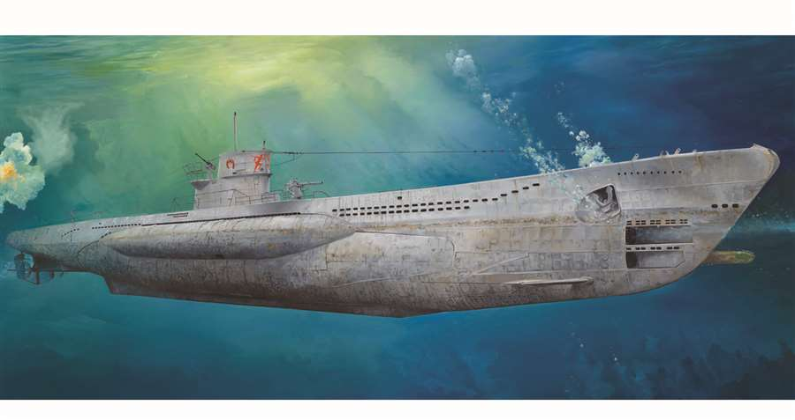
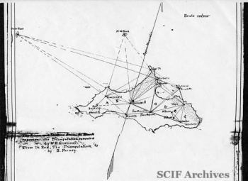
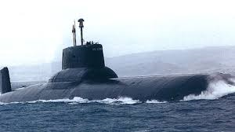
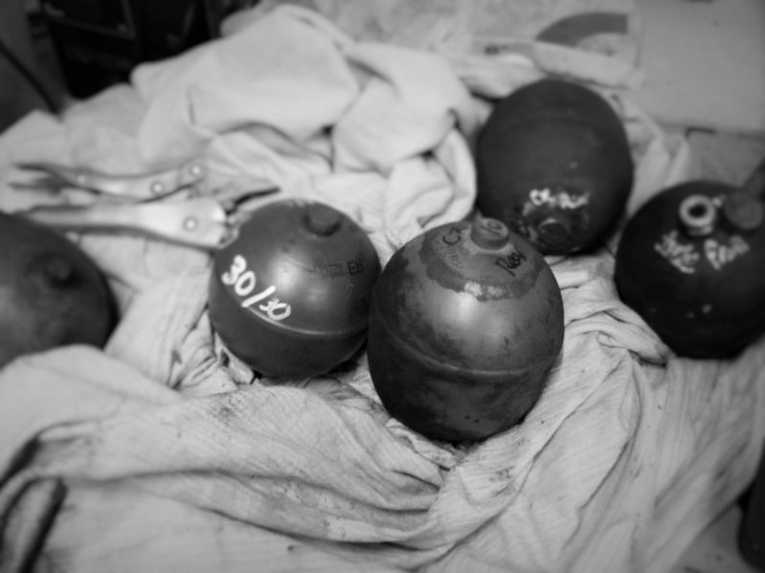
World war ii
“Acquired” by US Navy
Worked on Sonar detection
U-Boats
SOFAR Sphere
Triangulate location
Ships, downed airmen
Sphere would implode at certain depth
No moving parts
Drop over side, wait, drop another
Never used operationally

Slide 60
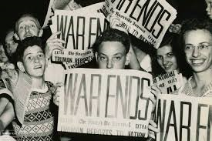
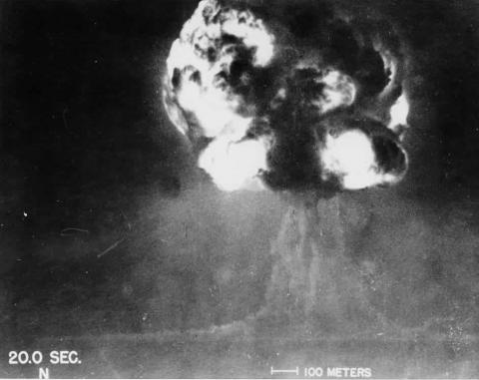
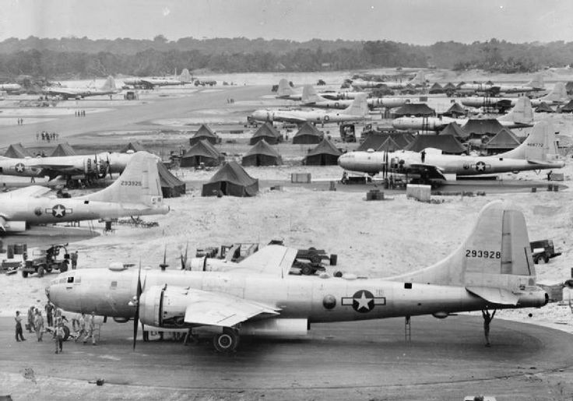
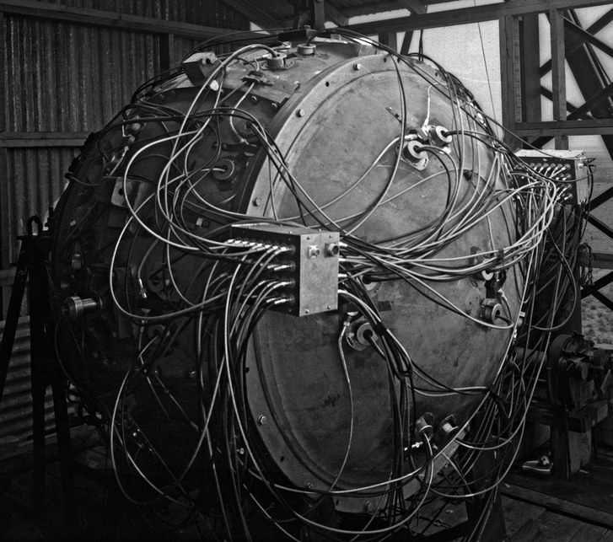
War ends
US only country with atomic weapons
Fears USSR may catch up
USSR will develop the technology! When?
How can the US detect if the USSR detonates a atomic weapon?

Slide 61
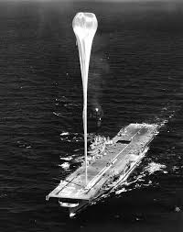
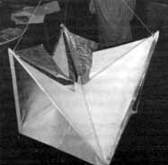
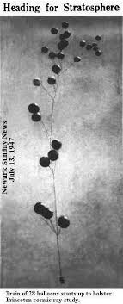
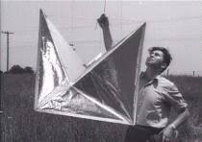
Project mogul
What if the SOFAR Channel existed in the sky?
Altitude, air pressure, temperature
155,000 ft
Started in 1946, Watson Laboratories in Red Bank New Jersey. Assistance from specialists from New York University, Columbia University
Meteorologists, electrical engineers, chemists
Balloon fitted with radar reflectors, radio transmitters, and disc microphones to provide location and feasibility of high altitude SOFAR Channel
First used clusters rubber neoprene, replaced by polyethylene balloons
Constant altitude for weeks
Pressure, ballast, and barometric sensors
25 July 1946 Operation Crossroads Test
Ascension Island low-freq acoustic test
Tested in New Jersey and Pennsylvania

Slide 62
Tests
Test No. Date / Launch Location Material Recovery Location
I NYU 1 3 April 1947 / Bethlehem, PA Neoprene Sandy Hook, NJ
I NYU 2 18 April 1947 / Bethlehem, PA Neoprene Unknown (equipment, Heligoland Test)
I NYU 3 29 May 1947 / Alamogordo, NM Neoprene Unknown (no equipment)
I NYU 4 4 June 1947 / Alamogordo, NM Neoprene Unknown (Walker Ranch, equipment)
I NYU 5 5 June 1947 / Alamogordo, NM Neoprene East of Roswell, NM (success)
I NYU 6 7 June 1947 / Alamogordo, NM Neoprene South of Highrolls, NM
II NYU 7 3 July 1947 / Alamogordo, NM Polyethylene Unknown
II NYU 8 4 July 1947 / Alamogordo, NM Polyethylene Unknown
II NYU 9 5? July 1947 / Alamogordo, NM Polyethylene Unknown
II NYU 10 6? July 1947 / Alamogordo, NM Polyethylene Unknown
Sources: NYU Progress Report No. 6, Section II, Pg. 5, 15 July 1949
Progress Summary Report on USAF Guided Missile Test Activities Vol. 1, Aug 1, 1948

Slide 63
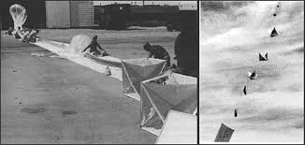
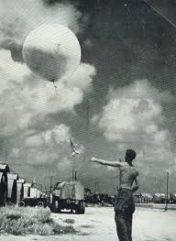
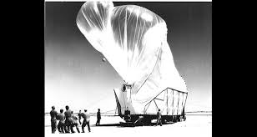
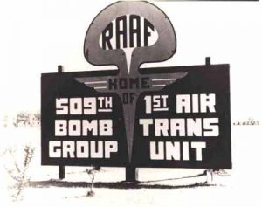
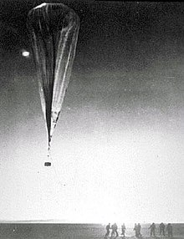
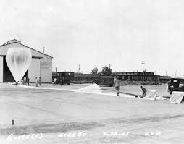
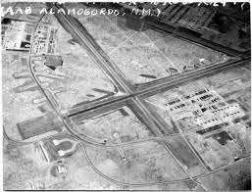
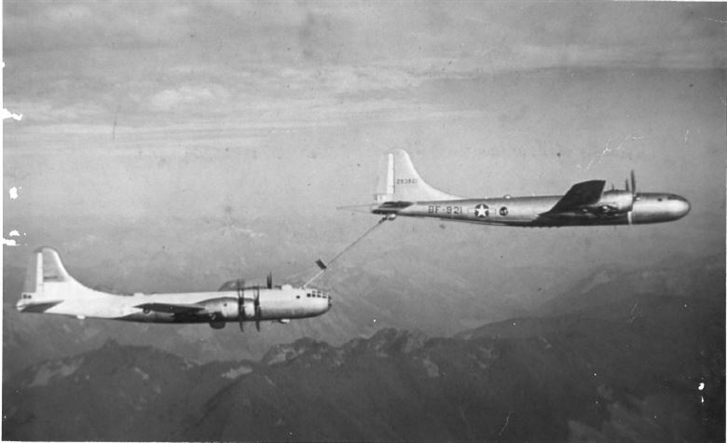
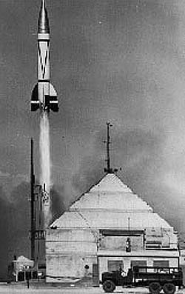
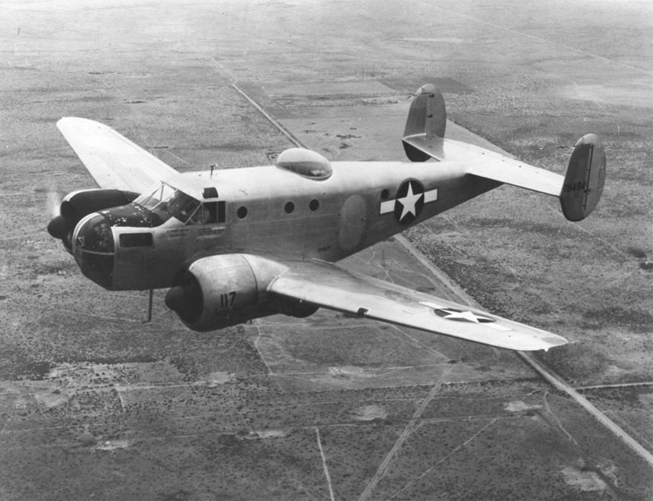
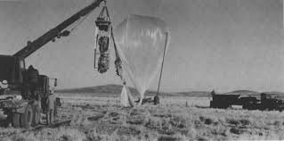
Why New Mexico?
White Sands Test Range
Alamogordo Air Base
Top Secret activities not out of ordinary
Heavy Security
Abundance of specialized locations and individuals in the area
Infrastructure matched needs

Slide 64
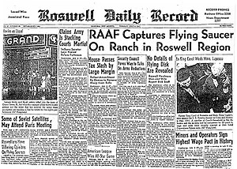
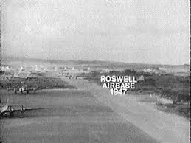
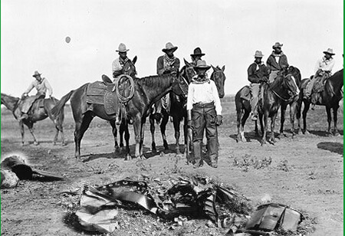
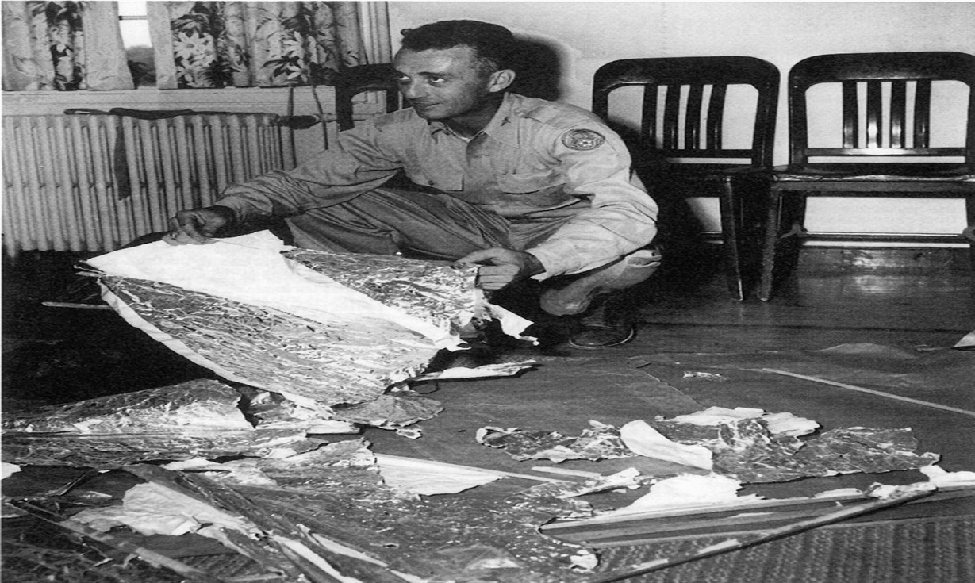
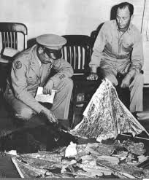
Roswell, New Mexico 1947
Mid-Late June, ~14 June, ranch hand William “Mac” Brazel encountered shiny metallic material while checking fences
Baroclinic wind storms 4-7, 9,10 June, high altitude cyclones
~4 July returned with family and gathered up debris
7 July brought the material to local sheriff, suggested taking it to the Roswell Army Air Base
8 July Roswell Army Air Base Public Relations issues statement
9 July Roswell Daily Record releases story

Slide 65


Slide 66


Slide 68
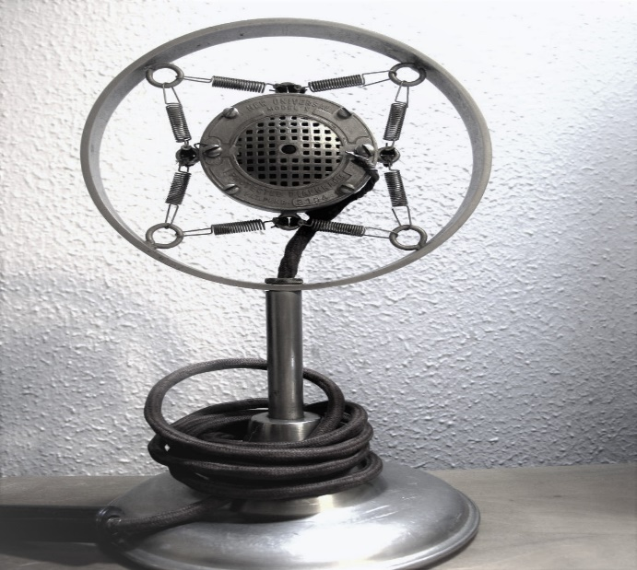
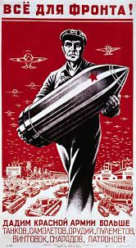
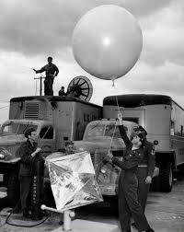
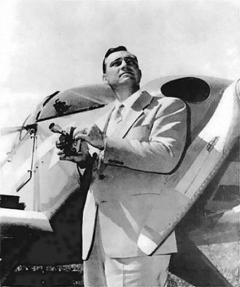
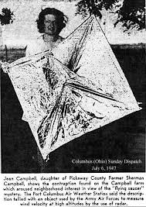
Weather balloon Conspiracy
Do not let USSR suspect the US was capable of detecting explosion
24 June 1947 Kenneth Arnold, Mt Rainer
25 July 1947 Seattle
5 July 1947 Sherman and Jean Campell, Circleville Ohio
Discovered radar reflector, Columbus paper published 6 July 1947
Weather Balloon
9 July Roswell Daily Record releases story
Confusion
Weather balloon vs high altitude balloon vs radar relector vs flying disc
Strange symbols
Cover up?
Flying disc microphone
Carbon Microphone. Disc microphone, used springs to prevent feedback
High output, low wattage
Flying disc microphone
Radio receiver, microwave oven

Slide 69
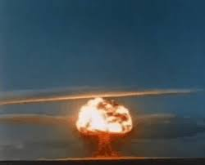
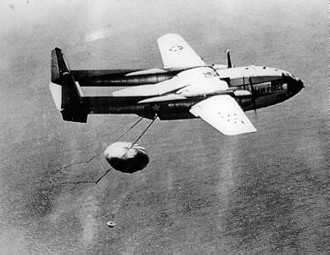
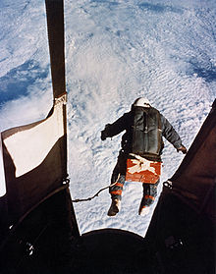
Conclusion
"Operationally it was a nightmare, but scientifically it was a great success," Dr. Charles B. Moore, Project Mogul's Operations Engineer
"It was like having an elephant in your backyard,“ Colonel Trakowski, USAAF/USAF Operations Officer assigned to Project Mogul
Before use of satellites or radiological flights, one of the few ways to gather intelligence of USSR atomic detonation
1946-1950
Detected first USSR atomic detonation in 1949
Replaced by seismic sensors
Cheaper and easier to work with
Provided valuable data about upper limits of the atmosphere
Information used by NASA and USAF during space flight research
Furthered development, research, and construction of high altitude balloons
Operation Skyhook, Operation Moby Dick, Operation Manhigh, Operation Excelsior

Slide 70

Summary
Who?
What?
World War II
War Ends
Project Mogul
Why?
New Mexico 1947
Weather Balloon Conspiracy
Conclusion

Slide 71
Sources
https://oceanexplorer.noaa.gov/explorations/sound01/background/acoustics/media/sofar.html
https://www.nytimes.com/1994/09/18/us/wreckage-in-the-desert-was-odd-but-not-alien.html?pagewanted=all
https://books.google.com/books?id=qrsIzxnsAjgC&pg=RA1-PA4&lpg=RA1-PA4&dq=colonel+trakowski&source=bl&ots=nQN7Op63ZV&sig=YNyZbAvPQkX5eSAXuGoc6pA_pmQ&hl=en&sa=X&ved=0ahUKEwjwxI_t4pLcAhVO6lMKHc_HApwQ6AEILDAB#v=onepage&q=toy&f=false
https://www.smithsonianmag.com/smithsonian-institution/in-1947-high-altitude-balloon-crash-landed-roswell-aliens-never-left-180963917/

Slide 72
DO’s Comments

Slide 73
CC’s Comments

